Slide 1
Shallow Fermionic Shadow
Bian Kaiming
Collaborate:
Manhong Yung and Bujiao Wu
2024.3.1

Slide 2
Overview
Classical shadows
Motivation
State tomography
Shadow protocol
Shallow shadows
Shallow Fermionic shadows
Fermionic quantum compute
Match gates
Shallow Fermionic shadows

Slide 3
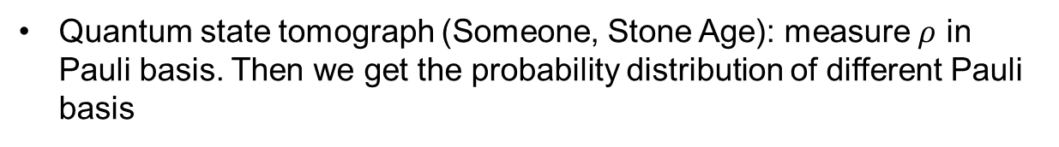
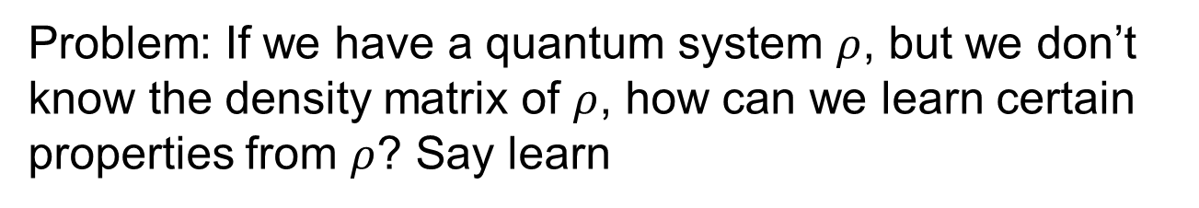
Motivation:
Readout properties from quantum system
Problem: If we have a quantum system $ρ$, but we don’t know the density matrix of $ρ$, how can we learn certain properties from $ρ$? Say learn
Quantum state tomograph (Someone, Stone Age): measure $ρ$ in Pauli basis. Then we get the probability distribution of different Pauli basis
And we know the expectation value of Paulis. Finally, we get $tr(ρO)$
Defect: The sample complexity scales exponential.

Slide 4


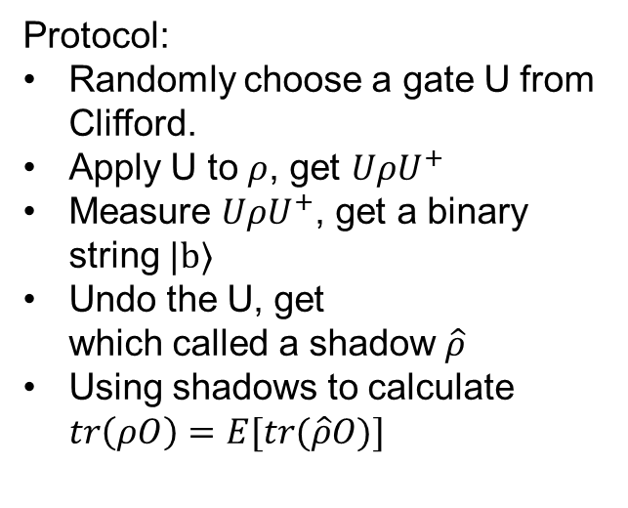

Classical shadows:
A way out of exponential
Classical shadows (Huang, 2020): Using random shadows (or say projections, sections) to predict the expectation value.
Protocol:
Randomly choose a gate U from Clifford.
Apply U to $ρ$, get $UρU^{+}$
Measure $UρU^{+}$, get a binary string $|b⟩$
Undo the U, get which called a shadow $\hat{ρ}$
Using shadows to calculate $tr\left(ρO\right)=E[tr(\hat{ρ}O)]$
$$ρ$$
(pennylane.ai)
Strictly saying: $\hat{ρ}=M^{−1}\left(U^{+} | b\right\rangle \left\langle b | U\right)$

Slide 5
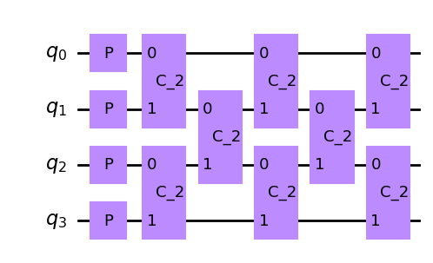
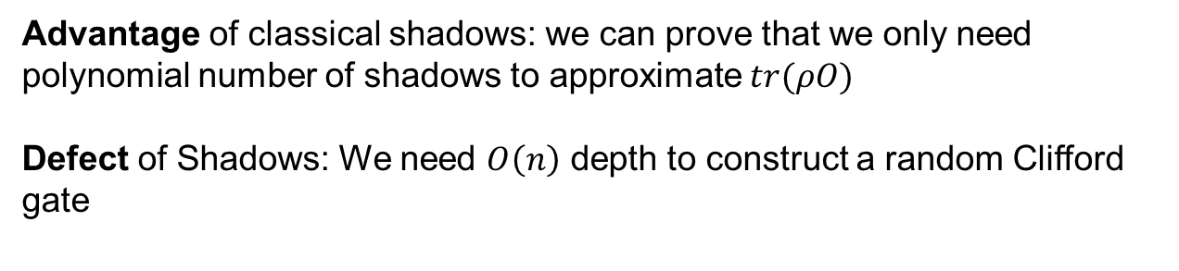
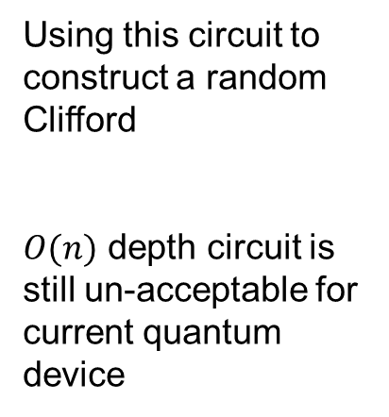

Shadows to shallow shadows
Advantage of classical shadows: we can prove that we only need polynomial number of shadows to approximate $tr(ρO)$
Defect of Shadows: We need $O\left(n\right)$ depth to construct a random Clifford gate
$O\left(n\right)$ depth
Using this circuit to construct a random Clifford
$O(n)$ depth circuit is still un-acceptable for current quantum device
Random Pauli
Random 2 bits Clifford

Slide 6
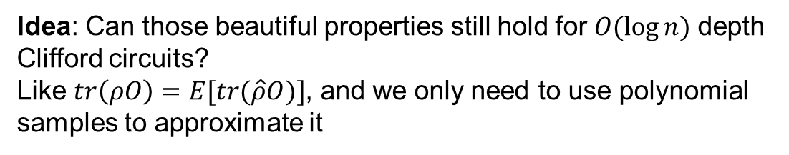


Shallow shadows
Idea: Can those beautiful properties still hold for $O(\log{n})$ depth Clifford circuits?
Like $tr\left(ρO\right)=E[tr(\hat{ρ}O)]$, and we only need to use polynomial samples to approximate it
Shallow shadows (Christian, Jens, et.al. , 2023):
Yes, they holds.
$$tr\left(ρO\right)=E[tr(\hat{ρ}O)]$$
$O\left(\log{n}\right)$ depth
( can also be efficiently computed )

Slide 7
Thank you for listening

Slide 8
Shallow Fermionic shadows
Fermionic quantum compute

